Slide 1
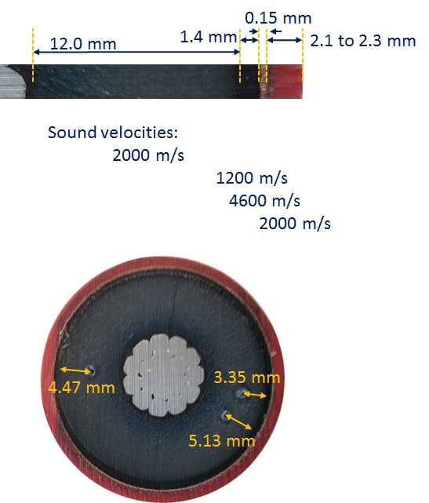
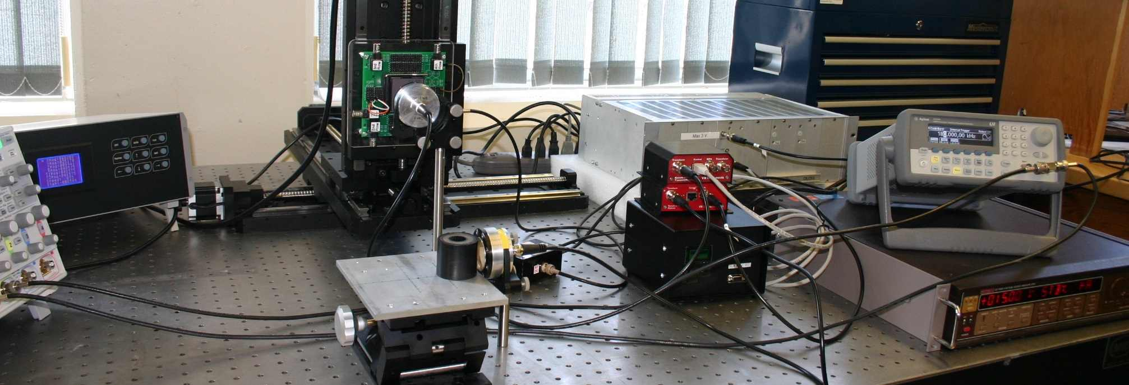
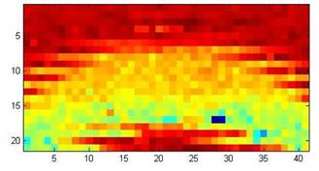
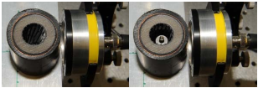
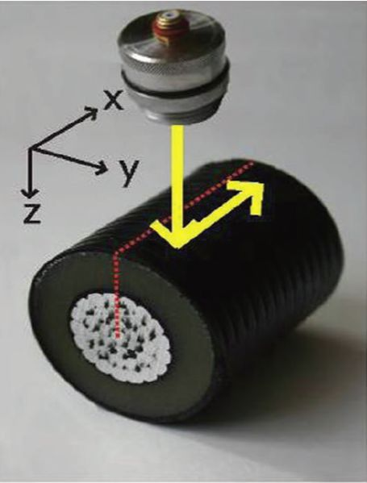


ABSTRACT
In 2012, over 600,000 people were directly affected by power loss, in Canada. Power distribution failures are one of the key factors in electrical power interruption, and effective prevention maintenance can increase system reliability. The main cause of distribution failure is the formation of water trees in the cross-linked polyethylene (XLPE) insulation of underground power cables (“Morin .M & others, 2012”). The number and size of these faults is used to determine the condition of the insulation, and is used in order to prioritize repairs.
The current method used by Manitoba Hydro is very time consuming and requires a lot of effort. This leads to delays in repairs which means that people are left without badly needed electricity for longer periods of time. The method that I have used is sending low frequency (700 KHz) ultrasonic waves through the insulation, to determine where the damage is located, and how much damage there is.
My method is much less time consuming and requires less energy. Using low frequency ultrasound means that there is less attenuation than high frequency waves and that they can be used more accurately in order to find faults in the XLPE insulation.
BACKGROUND & RATIONALE
Thousands of kilometres of underground XLPE Power cables make up the power distribution grids around the world. The formation of water trees causes power distribution failures, which leads to the failure of the power cables (“Morin .M & others, 2012”). Water trees are regarded as being micro-fissures around water droplets within the XLPE insulation. The current method used by Manitoba Hydro is time, and energy consuming, as well as being destructive .This causes delays in repairs, leaving people without much needed electricity for longer periods of time.
Sound travels at different speeds through different materials (Figure 1). Thus the properties of the sound wave (the amplitude, wavelength, frequency…etc.) will be different as well. The chemical composition of water trees are different than the insulation that surrounds them, and this then causes a contrast in, the acoustical impedance of these faults. Using this logic I found that by using low frequency sound waves, water tree damage can be found faster, non-destructively, and overall more effectively. ‘’’
Figure 1
HYPOTHESIS & OBJECTIVES
I hypothesized that water trees can be found by using low frequency ultrasound, within the frequency range of 15 KHz – 10 MHz (“E. Blomme & others, 2002”).
Specific Objectives
To find a non-destructive method of microscopic fault detection in the insulation of XLPE power cables.
To ensure that this new method is less time, and energy consuming then the current standard.
PROCEDURES
The current method used by Manitoba Hydro involves the following steps.
1) A failed sample is received from the field, and the conductor is removed.
2) A modified wood working mitre slices the cable into 1.00 mm wafers (Figure 2)
3) The wafers are boiled in water for one hour, and this accentuates the water trees.
4) The wafers are analyzed under a microscope (Figure 3) where faults are detected.
5) This information is used to prioritize repairs.
A sample with water tree damage that was borrowed from Manitoba Hydro, and waves were sent through it at 500 KHz (“E. Blomme & others, 2002”), in order to see if the difference in amplitude and acoustic impedance was significant enough for accurate detection. After concluding that there was a significant difference (Figure 4), tests to determine if the wave will penetrate through the entire insulation, and the required frequency were executed. In order to see if the ultrasound waves was penetrating through the entirety of the insulation I did multiple tests with a power cable that did not have a core. A foreign object would be placed in the empty center (Figure 5), and the amplitude was observed. Also, a cable without the object in the center was used as a control.
When the frequency of a wave is too low, the resolution of the image will not be high enough for proper testing, while if it is too high then the amount of attenuation (in the air, as well as the medium) would make the data received imprecise, and useless. Tests were done at 15 KHz (increasing by 100 KHz) and at 10 MHz (decreasing by 1MHz) until a frequency was found that had considerably low attenuation as well as having a resolution high enough for accurate analysis.
Finally, the main test was performed. Multiple faults were created at different locations; in order to see if that would cause any issues. Also, by creating the faults I have a control, whereas otherwise I would have no reference as to whether the transducer was accurately finding faults. This involved placing a transducer 1 cm above the axis of symmetry of a cable sample. A wave would be sent through the cable, and it would be rotated 8.1° (on the y-axis), until a complete scan of one layer of the cable was completed. Transducer would then be move backwards (in the x-direction), until a complete scan of the cable was completed (Figure 6). The data from all tests was analyzed, and more tests were taken, until I was confident with the certainty of my results.
Figure 2
Figure 3
Figure 4
Figure 5
Figure 6
Control
Variable
REFERENCES
E. Blomme, D. Bulcaen, and F. Declercq, “Air-Coupled Ultrasonic NDE: Experiments in the frequency Range 750 KHz – 2 MHz,” NDT&E International, vol.35, pp417-426, 2002.
T .E. Gomez Alvarez-Arenas, “Acoustic Impedance Matching of Piezoelectric Transducers in the Air,” IEEE Transactions on Ultrasonics Symposium 2000.
T. E. Gomez, and F. Montero, “Bridging the Gap of Impedance Mismatch Between Air and Solid Materials,” IEEE Ultrasonics Symposium, 2000.
A. Vladisaskas, and L. Jakevicius, “Absorption of ultrasonic waves in air,” Ultragarsas Journal, vol. 50, No. 1, 2004.
M. Morin, K. Hamilton, T. Found, G. Klassen, G. Miskiewiez, D. Mulla,. . . J. Waddell, “Report on Distribution Asset Condition”. Vol.2, (2012, August 14).

Slide 2
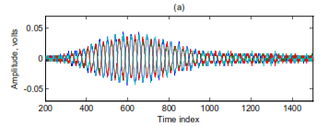
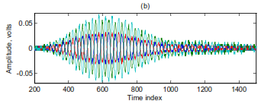
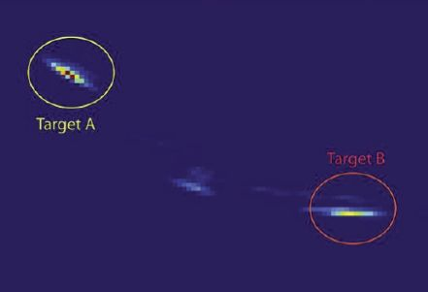
RESULTS & OBSERVATIONS
Preliminary Tests
Control Group
Experimental Group
Main Evidence
Control Sample
Damaged Sample
Ultrasound Images
Ultrasound Synthetic Aperture Imaging
Amplitude Based Ultrasound Imaging
CONCLUSIONS
It is evident from the present study that:
It is possible to find water tree damage in cross-linked polyethylene power cables with the use of low frequency ultrasound waves.
The location, as well as the extent, of the water tree damage can be found accurately and effectively by using a this technique.
Accurate results can be obtained at a frequency of 700 KHz. Samples taken at this frequency have limited attenuation, as well as producing an image at a resolution high enough for accurate detection. Frequencies higher than this create a higher resolution image, but the attenuation is too severe and renders the data useless. Also, at frequencies lower than this, the resolution becomes too low to accurately conclude anything about the water trees.
The method that I have found is more applicable than the current standard, used by Manitoba Hydro. It is less time, and energy consuming than the splicing method.
This solution will drastically decrease the amount of time necessary for making repairs to underground XLPE power cables. This will decrease the time needed for finding repairs, thus increasing the speed of repairs and ensuring that communities have electricity.
SIGNIFICANCE
Electricity is a need for today’s society. It is a major power source that is used for lighting, heating, and even keeping essential facilities like hospitals and research labs running. The absence of electricity would mean that all of the above, and many more, would cease to. In order to repair faults in power cables, companies like Manitoba Hydro , first analyze the extent of the damage in order to prioritize repairs. The current standard that is used for this (refer to my procedures) is very time, and energy consuming. Almost all of the work is done manually, and this is not only slower, but can result in more errors if not carefully completed. The method that I have created is less time consuming, as sample are taken at the speed of sound, and it is less energy consuming as majority of the manual work is done my a computer program. With the use of my technique, faults in XLPE power cables can be found quicker and more effectively, which means that people will not be without essential electricity for extended periods of time.
FUTURE DIRECTIONS
ACKNOWLEDGEMENTS
Though this project may be over, this is only the beginning. There are many ways that this project can be expanded upon. The current technology for the transducer that was used is very new and only two companies in the world make it. As the quality of the transducer increases, so will the accuracy of this technique. This technique can be, modified to be done in the field, by having an external power source and recording the data in a hard drive. This would make this technique even more effective and make it completely non-destructive. As time progresses, more applications/ expansions of this project will come to light.
I am grateful to my mentor Dr. Gabriel Thomas for his valuable guidance, suggestions, and expert knowledge which guided me on this difficult project. I would like to thank
Mrs. Kathleen Crang for inspiring me, and keeping my love for science alive. Finally, I express my deepest thanks to my parents for their unconditional support and encouragement. I am indebted to everyone who aided me on this project, whether it was directly with the project or not, because without them it would have been impossible for me to complete it.

